Slide 1

Content Optimization

Slide 2
How to make Content
Relevant, Engaging and Attractive
Content Quality
Content Quantity
Variety
Readability
Inbound link and outbound link
Keyword density

Slide 3
Seven Factors for Quality Content
User Intent
Well Crafted Main Content
Useful Supplementary Content
Page Layout
Ad Placement
Length Of Content
E-A-T
The 7 Key Factors That Define High Quality SEO Content (searchenginepeople.com)

Slide 4
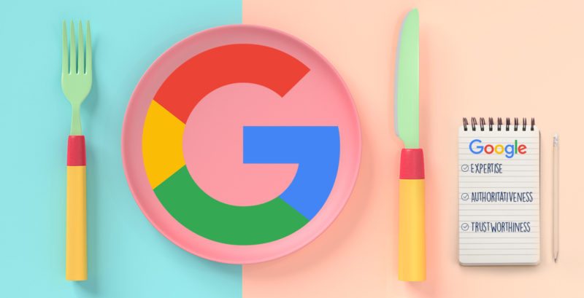
Content Quality
These quality guidelines cover the most common forms of deceptive or manipulative behavior, and Google may respond negatively to other misleading practices as well
Expertise
Authoritativeness
Trustworthiness
https://www.thebrandonagency.com/blog/how-to-use-googles-e-a-t-and-quality-guidelines-for-content-seo-success/

Slide 5


Google Webmaster Guidelines
The content should be the fresh and original one
The focus of your pages should be on users not on search engines
Understand your user first , what are his requirements, what actually they wants
Don’t try to deceive the users by writing irrelevant content
Think about what makes your website unique, valuable, or engaging
Make your website stand out from others in your field
Automatically generated content
Creating pages with little or no original content
Abusing rich snippets markup Cloaking
Hidden text and links and so many other things

Slide 6
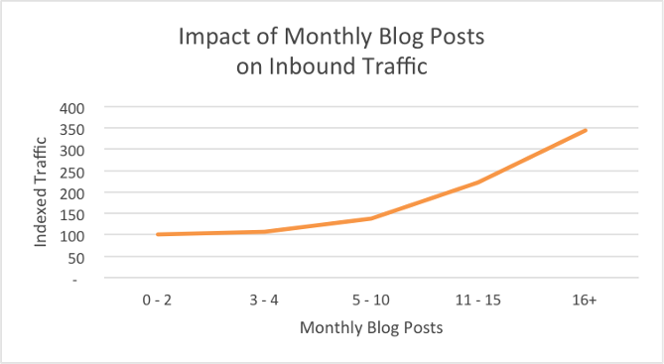
Content Quantity
The research shows that publishing more will only increase your inbound traffic.
Quantity really matter and depend on
Type of the Business
Complexity or Simplicity
https://neilpatel.com/blog/blog-post-quality-vs-quantity/

Slide 7
Content Variety
Text
Images
Videos
Info Graphs
Table

Slide 8
Content Readability
Readable content is easy for your audience to consume and understand. The content is skimmable, written at an appropriate reading level and uses succinct sentence structures and uncomplicated word choices
Tips for writing readable content
How to check the readability of your content
Make a strong first impression
Make it skimmable
Use relevant and natural language
Be conscious of word choice
The Flesch Reading Ease score is between 0 and 100, with 100 being the most readable. This blog by Harvard says to aim for a score of 60-70 for an adult readership.
https://www.brandpoint.com/blog/readable-content/#:~:text=Readable%20content%20is%20easy%20for,structures%20and%20uncomplicated%20word%20choices.

Slide 9
Internal and Outbound linking
Internal linking refers to linking any word, image, video or page to any other element within the website by putting hyper linking
An effective hyper linking is always considers good from SEO point of view
Outbound linking
Outbound linking is similar to internal linking with a difference that the target page is the any other page on the web except page of your website

